Slide 1
Group 11
Razvan muresan
Joseph shuttlewood
Tyler martignetti
John rance

Slide 2

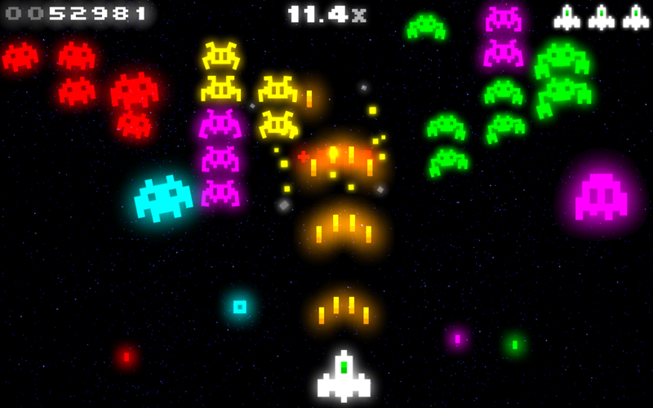
Neon art style

Slide 3

Main Menu

Slide 4
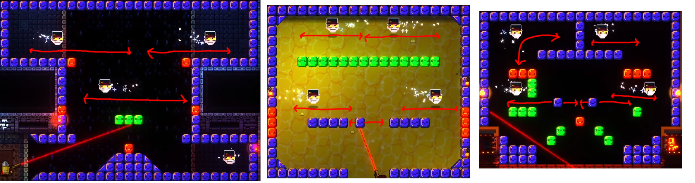
The Game

Slide 5
Overcoming first turn advantage
Player 2 gets to fire two bullets
Timer based. Player 1 has less time to think about his moves than Player 2
Level design in such a way that Player 1 can’t gain a significant advantage in the first turn

Slide 6
Block mechanics
Blocks that can benefit the current player on their next turn
Extra Time (Adds X amount of seconds to the player’s timer)
Reduce Movement Speed of Targets
Extra Point(s) (If the player destroys a target on their next turn, they are awarded extra points)
Blocks that can hinder the opposing player on their next turn
Reduced Time (Reduces the opponent’s timer by X amount of seconds)
Reduced Accuracy (The trace line moves slightly out of line of the turret’s aim – this is the direction in which the projectile will actually fire)
Increase Movement Speed of Targets

